Slide 1



Basics of Cryptography
Ms. Swati Mali
swatimali@somaiya.edu

Slide 2
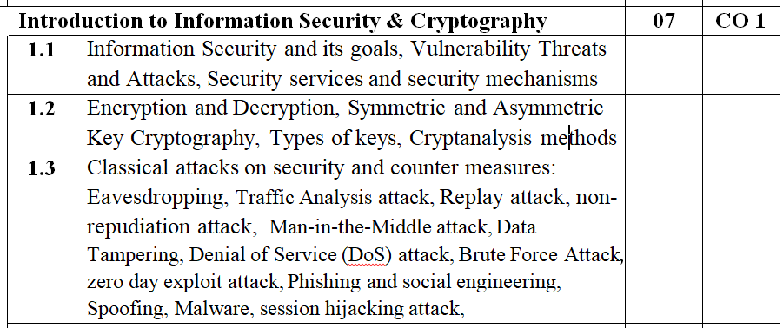
Module 1
Contents

Slide 3
Module 1.2
Cryptography
Word with Greek Origin
Means “Secret Writing”
Science & Art of transforming messages to make them secure and immune to attacks-Forouzan

Slide 4
Definitions
Plaintext-An original message
Ciphertext-The coded message
Enciphering or Encryption- The process of converting from plaintext to ciphertext
Deciphering or Decryption- Restoring the plaintext from the ciphertext

Slide 5
Definitions
Cryptography –
  The many schemes used for encryption constitute the area of study known as cryptography. Such a scheme is known as a cryptographic system or a cipher.
Cryptanalysis-
  Techniques used for deciphering a message without any knowledge of the enciphering details fall into the area of cryptanalysis.
  Cryptanalysis is what the layperson calls “breaking the code.”
Cryptology - The areas of cryptography and cryptanalysis together.

Slide 6
Stream Cipher Vs Block Cipher
Stream Cipher :
  stream cipher Converts the plain text into cipher text by taking 1 byte of plain text at a time.
Block Cipher :
  block cipher converts the plain text into cipher text by taking plain text’s block at a time

Slide 7
Stream Cipher Vs Block Cipher
Aspect | Stream Cipher | Block Cipher
Basic Concept | Encrypts data one bit or byte at a time. | Encrypts data in fixed-size blocks (e.g., 64 or 128 bits).
Processing | Continuous, works on data streams. | Discrete, processes data in chunks.
Speed | Generally slower, especially for real-time applications., discrete, exponential operations | Faster due to block-wise operations, Ex-OR operations
Complexity | Simpler implementation. | More complex design and implementation.
Mode of Operation | Doesn't require padding as it works bit-by-bit. | Requires padding if data size is not a multiple of block size.
Key Usage | Often uses a single key and generates a pseudorandom keystream. | Uses keys in conjunction with specific modes like ECB, CBC, etc.
Suitability | Best for applications needing real-time or streaming encryption (e.g., voice, video). | Best for encrypting files or data at rest.
Error Propagation | Errors affect only the bit/byte in question. | Errors can propagate throughout the block.
Security | Potential vulnerability to pattern attacks if the keystream is not truly random. | More robust due to structured modes of operation.
Examples | RC4, RSA, ECC | AES, DES, Blowfish.
7/21/2025

Slide 8
Stream Cipher Vs Block Cipher
Datasize?
  8 bits Vs 64, 128 bits?
Technique?
  stream cipher uses only confusion.
  Block cipher Uses confusion as well as diffusion
Applications?
  Short data
  Large data?
Strength?

Slide 9
Stream Cipher Vs Block Cipher
Block ciphers are More secure than stream ciphers when the same key is used multiple times; Stream ciphers are less secure than block ciphers when the same key is used multiple times

Slide 10
Symmetric Encryption
A symmetric encryption scheme has five ingredients
Plaintext
Encryption algorithm
Secret key
Ciphertext
Decryption algorithm

Slide 11
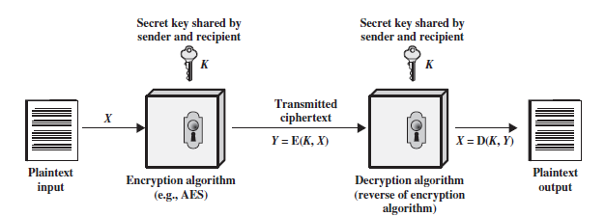
Symmetric Encryption

Slide 12
Symmetric Encryption
Plaintext
This is the original intelligible message or data that is fed into the algorithm as input.
Encryption algorithm
The encryption algorithm performs various substitutions and transformations on the plaintext.

Slide 13
Symmetric Encryption
Secret key:
The secret key is also input to the encryption algorithm.
The key is a value independent of the plaintext and of the algorithm.
The algorithm will produce a different output depending on the specific key being used at the time.
The exact substitutions and transformations performed by the algorithm depend on the key.

Slide 14
Symmetric Encryption
Cipher text
This is the scrambled message produced as output.
An apparently random stream of data and, as it stands, is unintelligible.
It depends on the plaintext and the secret key.
For a given message, two different keys will produce two different cipher texts.

Slide 15
Symmetric Encryption
Decryption algorithm
This is essentially the encryption algorithm run in reverse.
It takes the cipher text and the secret key and produces the original plaintext.

Slide 16
Symmetric Encryption
Requirements for secure use of conventional/Symmetric encryption:
A strong encryption algorithm.
Secure Secret Key

Slide 17
Symmetric Encryption
A strong encryption algorithm.
Even if the opponent knows the algorithm and has access to one or more ciphertexts, Still would be unable to decipher the ciphertext or figure out the key.
The opponent should be unable to decrypt ciphertext or discover the key even if he or she is in possession of a number of ciphertexts together with the plaintext that produced each ciphertext.

Slide 18
Symmetric Encryption
Secure Secret Key-
Sender and receiver must have
  obtained copies of the secret key in a secure fashion and
  must keep the key secure.
If someone can discover the key and knows the algorithm, all communication using this key is readable.

Slide 19
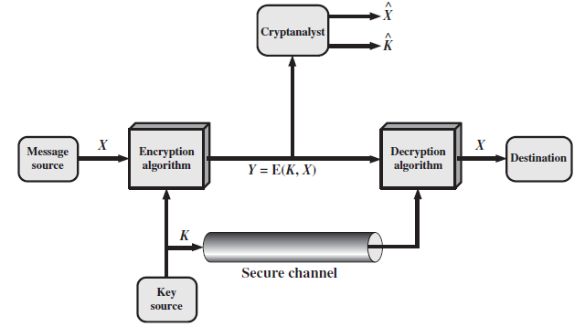
Model of Symmetric Cryptosystem

Slide 20
Model of Symmetric Cryptosystem
A source produces a message in plaintext,
X = [X1, X2, …………, XM].
The M elements of X are letters in some finite alphabet(26 Capital letters or {0,1})
Key generation
K = [K1, K2, c, KJ]
If the key is generated at the Message source or Third Party, delivered to the destination by means of some secure channel.

Slide 21
Model of Symmetric Cryptosystem
Cipher text generation
Y = [Y1, Y2, ….., YN].
Y = E(K, X)
Y is produced by using encryption algorithm E as a function of the plaintext X, the value of the key K.
The intended receiver, in possession of the key, is able to invert the transformation:
X = D(K, Y)

Slide 22
Categories of Cryptographic System
Characterized along three independent dimensions:
The type of operations used for transforming plaintext to cipher text.
The number of keys used.
The way in which the plaintext is processed.

Slide 23
Categories of Cryptographic System
The type of operations used for transforming plaintext to cipher text-
All encryption algorithms are based on two general principles:
Substitution
Transpositions

Slide 24
Categories of Cryptographic System
Substitution
Each element in the plaintext (bit, letter, group of bits or letters) is mapped into another element
Transposition
Elements in the plaintext are rearranged.
The fundamental requirement is that no information be lost (i.e., that all operations are reversible).
Most systems involve multiple stages of substitutions and transpositions.

Slide 25
Categories of Cryptographic System
The number of keys used-
If both sender and receiver use the same key, the system is referred to as symmetric, single-key, secret-key, or conventional encryption.
If the sender and receiver use different keys, the system is referred to as asymmetric, two-key, or public-key encryption.

Slide 26
Categories of Cryptographic System
The way in which the plaintext is processed-
A block cipher processes the input one block of elements at a time, producing an output block for each input block.
A stream cipher processes the input elements continuously, producing output one element at a time, as it goes along.

Slide 27
Cryptanalysis and Brute-Force Attack
The objective of attacking an encryption system is
To recover the key in use rather than simply to recover the plaintext of a single ciphertext.
Why?

Slide 28
Cryptanalysis and Brute-Force Attack
There are two general approaches to attacking a conventional encryption scheme:
  Cryptanalysis
  Brute-force attack

Slide 29
Cryptanalysis and Brute-Force Attack
Cryptanalysis:
Cryptanalytic attacks rely on
  the nature of the algorithm or
  the general characteristics of the plaintext or
  even some sample plaintext–ciphertext pairs.
This type of attack exploits the characteristics of the algorithm to attempt to deduce a specific plaintext or to deduce the key being used.

Slide 30
Cryptanalysis and Brute-Force Attack
Brute-force attack:
The attacker tries every possible key on a piece of ciphertext until an intelligible translation into plaintext is obtained.
On average, half of all possible keys must be tried to achieve success.
Involves trying every possible key until an intelligible translation of the ciphertext into plaintext is obtained.
On average, half of all possible keys must be tried to achieve success.
That is, if there are X different keys, on average an attacker would discover the actual key after X/2 tries

Slide 31
Cryptanalysis and Brute-Force Attack
If either type of attack succeeds in deducing the key, the effect is catastrophic
All future and past messages encrypted with that key are compromised.

Slide 32
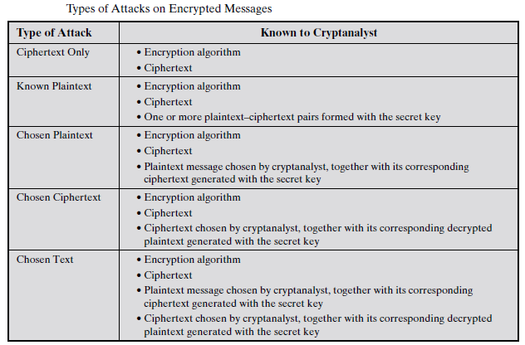
Cryptanalysis and Brute-Force Attack
Summary of the various types of cryptanalytic attacks based on the
amount of information known to the cryptanalyst.

Slide 33
Cryptanalysis
Cryptanalysis is the study and process of analyzing and decrypting ciphers, codes, and encrypted text without using the real key.
Alternately, we can say it’s the technique of accessing a communication’s plain text content when you don’t have access to the decryption key.
Put simply, cryptanalysis is the practice, science, or art of decrypting encrypted messages.

Slide 34
Cryptanalysis
Cryptanalysis experts study ciphers, cryptosystems, and ciphertext to understand their functions.
Then, they use that knowledge to find or improve techniques to weaken or defeat them.
Cryptographer : one who writes encryption code used in cybersecurity,
Cryptoanalyst : one who tries to crack those encryption codes.
Two opposing sides of the cybersecurity coin, locked in conflict, trying to one-up the other, constantly inventing new measures and countermeasures.

Slide 35
Who Uses Cryptanalysis?
Hackers use cryptanalysis.
Would-be hackers use cryptanalysis to root out cryptosystem vulnerabilities rather than a brute force attack.
Governments use cryptanalysis to decipher the encrypted messages of other nations.
Companies specializing in cybersecurity products and services use cryptanalysis to test their security features.
Even the world of academia gets in on the action, with researchers and academicians looking for weaknesses in cryptographic algorithms and protocols.
Black-hat hackers use it to commit cybercrimes, and white-hat hackers use it to conduct penetration testing as directed by organizations that hire them to test their security.

Slide 36
Cryptanalysis Attacks and Techniques
1. Ciphertext-Only Attack
The attacker only has access to :
  at least one encrypted message
  but does not know the plaintext data, any cryptographic key data used, or the encryption algorithm being employed.
  Intelligence agencies often face this challenge when they've intercepted encrypted communications from a target.
  However, this is a formidable attack to pull off, thanks to the lack of target data.

Slide 37
Ciphertext-Only Attack (COA)
Problem: cryptanalyze : "DQG D FKLOG UHQWLQJ."
Assume the cipher is a Monoalphabetic substitution cipher. Decrypt the message.
Solution:
Since only the ciphertext is given, try all possible cipher shifts (brute force).
Shifting letters by 3 (common Caesar cipher key):
  'D' → 'A', 'Q' → 'N', 'G' → 'D', etc.
Decrypted text: "AND A CHILD RENTING."
Success with a shift of 3.

Slide 38
Cryptanalysis Attacks and Techniques
2. Known Plaintext Attack
  This attack is easier to implement, compared to the ciphertext-only attack.
  analyst most likely has access to some or all the ciphertext’s plaintext.
    E.g. Hello in beginning or Regards in the end of message
  The goal is to discover the key the target uses to encrypt the message and use the key to decrypt the message.
  Once the key is discovered, the attacker can decrypt every message encrypted with that specific key.
  Known plaintext attacks rely on the attacker finding or guessing all or part of an encrypted message, or alternately, even the original plaintext's format.

Slide 39
Known Plaintext Attack (KPA)
Problem:
You know the plaintext "HELLO" maps to the ciphertext "KHOOR" using a Caesar cipher.
Decrypt "ZRUOG."
Solution:
Calculate the shift:
  'H' → 'K' (shift of 3).
Use this shift to decrypt "ZRUOG":
  Z → W, R → O, U → R, L → I, G → D.
Decrypted text: "WORLD."

Slide 40
Known Plaintext Attack (KPA)
Problem: You know the plaintext "ATTACK" maps to ciphertext "DWWDFN" using a substitution cipher. Decrypt "FDWDWDFNHUV."
Solution:
Determine the shift:
  A → D (shift of 3).
Decrypt "FDWWDFNHUV" by reversing the shift:
  F → C, D → A, W → T, etc.
Decrypted text: "CAT ATTACKERS."

Slide 41
Cryptanalysis Attacks and Techniques
3. Chosen Plaintext Attack
Analysts using a chosen plaintext attack either already knows the encryption or can use the device used for encryption.
The cryptanalyst can then encrypt the chosen plaintext using the targeted algorithm to gather information regarding the key.

Slide 42
Chosen Plaintext Attack (CPA)
Problem: You suspect a substitution cipher, as “CAT" = “FDW."
Decrypt the ciphertext "LQIRUPDWLRQ" using the known plaintext.
Solution:
Map plaintext to ciphertext:
  C → F, A → D, T → W
Use the substitution mapping to decode other ciphertext messages.
For "LQIRUPDWLRQ", apply the reverse mapping:
Decrypted text: "INFORMATION."

Slide 43
Chosen Plaintext Attack (CPA)
Problem: You suspect a transposition cipher with "HELLO" = "LEHLO."
Decrypt the ciphertext "LEHLO" using the pattern observed.
Solve it..

Slide 44
Chosen Plaintext Attack (CPA)
Problem: You suspect a transposition cipher with "HELLO" = "LEHLO."
Decrypt the ciphertext "LEHLO" using the pattern observed.
Solution:
Analyze how plaintext maps to ciphertext:
  "HELLO" → "LEHLO" (swap positions 1↔2, 4↔5).
Apply the same swaps in reverse:
  Ciphertext "LEHLO" → Plaintext "HELLO."

Slide 45
Cryptanalysis Attacks and Techniques
4. A chosen-ciphertext attack
cryptanalyst can analyse any chosen ciphertexts together with their corresponding plaintexts.
the goal is to acquire a secret key or to get as many information about the attacked system as possible.
The attacker has capability to make the victim (who obviously knows the secret key) decrypt any ciphertext and send him back the result.
By analysing the chosen ciphertext and the corresponding received plaintext, the intruder tries to guess the secret key which has been used by the victim.
Chosen-ciphertext attacks are usually used for breaking systems with public key encryption.
For example, early versions of the RSA cipher were vulnerable to such attacks. They are used less often for attacking systems protected by symmetric ciphers. Some self-synchronizing stream ciphers have been also attacked successfully in that way.

Slide 46
Chosen Ciphertext Attack (CCA)
Problem: You submit "KHOOR" (Caesar cipher) for decryption and receive "HELLO.“
Decrypt "FRQJUDWXODWLRQV."
Solution:
From the given decryption, the cipher uses a Caesar shift of 3 (reverse each letter by 3).
Decrypt "FRQJUDWXODWLRQV":
  F → C, R → O, Q → N, G → D, etc.
Decrypted text: "CONGRATULATIONS."

Slide 47
Summary
Ciphertext-only attack: Attacker only has access to ciphertext. This is the most challenging scenario.
Known-plaintext attack: Attacker has access to both ciphertext and corresponding plaintext.
Chosen-plaintext attack: Attacker can choose plaintext and obtain corresponding ciphertext.
Chosen-ciphertext attack: Attacker can choose ciphertext and obtain corresponding plaintext

Slide 48
Cryptanalysis of Classical Ciphers
Caesar Cipher
  Brute-force attack: try all 25 possible key shifts.
  Frequency analysis
Rail Fence Cipher
  Brute-force attack: test different numbers of "rails" until a meaningful plaintext emerges.
  Visual inspection: For short ciphertexts, visual inspection and rearranging the characters can sometimes reveal the plaintext

Slide 49
Columnar Transposition Cipher
  Anagramming and Columnar Transposition: Explain the process.
  Brute-force attack: Discuss brute-forcing different key lengths and permutations. Mention the increasing complexity with longer keys.
  Frequency analysis: digraph and trigraph frequencies can aid in identifying column order
Playfair Cipher
  Frequency analysis: digraph frequencies can be used to identify common digraphs and infer the Playfair square structure.
  Known-plaintext attack: a small amount of plaintext-ciphertext pairs can be very effective in deducing the Playfair square.
  Brute-force attack: brute-forcing a Playfair cipher is significantly harder compared to the previous ciphers due to the larger key space (possible arrangements of the 5x5 grid).

Slide 50
Cryptanalysis Tools
Cryptol: This tool is an open-source license initially designed to be used by the Nation Security Agency (NSA), the United States intelligence agency, targeting cryptographic algorithms. Cryptol allows users to monitor how algorithms operate in programs that specify the ciphers or algorithms.
CrypTool: CrypTool is another open-source offering that creates elearning programs, plus a web portal designed to help users learn about cryptographic algorithms and cryptanalysis.
Ganzua: Ganzua is the Spanish term for a skeleton key or lockpick. It’s an open-source, multi-platform Java-based tool that allows analysts to define almost totally arbitrary cipher and plain alphabets. In addition, this function will enable users to crack non-English cryptograms.

Slide 51
Cryptanalysis
Problem:
The ciphertext is "BMODZBXDNABEKUDMUIXMMOUVIF", and you know the keyword is "MONARCHY". Decrypt the message.

Slide 52
Solution
Construct the Playfair Matrix:
Using the keyword "MONARCHY" (no repeated letters), fill a 5x5 grid:
M O N A R
C H Y B D
E F G I K
L P Q S T
U V W X Z
Decrypt Digraphs:
Ciphertext digraphs are BM, OD, ZB, XD, NA, BE, KU, DM, UI, XM, MO, UV, IF.
For each pair, locate letters in the grid:
  BM: 'B' (row 2, col 4) and 'M' (row 1, col 1). They form a rectangle. Swap columns: AN.
  OD: 'O' (row 1, col 2) and 'D' (row 2, col 5). Rectangle swap: RY.
  Continue for all pairs.
Final Decrypted Text:
Result: "AN INSTRUCTION IS IMPORTANT."

Slide 53
Cihertext-Only Attack
Problem:
The ciphertext is "WECRLTEERDSOEEFEAOCAIVDEN". The number of rails is unknown. Decrypt the message.

Slide 54
Test Different Rails:
Use trial and error to reconstruct plaintext by arranging the ciphertext in a zig-zag pattern.
W . . . E . . . C . . . R . . . L
. E . R . D . S . E . E . F . A .
. . O . . . C . . . A . . . I . V
Read horizontally: "WEAREDISCOVEREDFLEEATONCE"
Final Plaintext: "WE ARE DISCOVERED FLEE AT ONCE."

Slide 55
Columnar Transposition Cipher Cryptanalysis
Problem:
Ciphertext: "HWEOLRLLDO"
Key: "312“

Slide 56
Solution:
Arrange Ciphertext in Columns Based on Key:
Key: 3 1 2
3 | 1 | 2
---------
W | H | E
O | L | L
D | O | R
Rearrange Columns by Key Order:
Key Order: 1 2 3
H E W
L L O
O R D
Read Row by Row:
Plaintext: "HELLO WORLD."

Slide 57
Asymmetric cryptography
Public-key cryptography
Asymmetric cryptography,
A cryptographic system that uses pairs of keys
Public keys (which may be known to others),
Private keys (which may never be known by any except the owner).

Slide 58
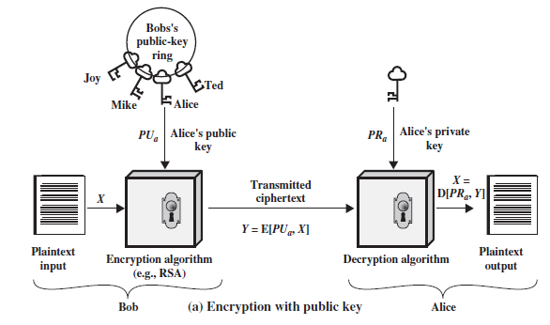
Asymmetric cryptography

Slide 59
Asymmetric cryptography
The essential steps are the following.
Each user generates a pair of keys to be used for the encryption and decryption of messages.
Each user places one of the two keys in a public register or other accessible file. This is the public key.
The companion key is kept private.
Each user maintains a collection of public keys obtained from others.

Slide 60
Asymmetric cryptography
The essential steps are the following.
If Bob wishes to send a confidential message to Alice
Bob encrypts the message using Alice’s public key.
When Alice receives the message, she decrypts it using her private key.
No other recipient can decrypt the message because only Alice knows Alice’s private key.

Slide 61
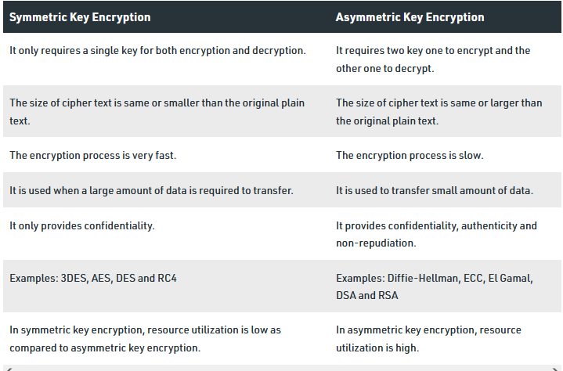
Difference between Symmetric and Asymmetric Encryption

Slide 62
Classical Encryption Techniques
Basic approaches to symmetric encryption
The two basic building blocks of all encryption techniques are-
  Substitution
  Transposition

Slide 63
Classical Encryption Techniques
Substitution Techniques:
Monoalphabetic Cipher: Caesar Cipher
Playfair Cipher
Transposition Techniques
Rail Fence
Rectangle Transposition

Slide 64
Transposition Techniques
Substitution-All the techniques involve the substitution of a ciphertext symbol for a plaintext symbol.
Transposition cipher-
A very different kind of mapping achieved by performing some sort of permutation on the plaintext letters.

Slide 65

Transposition Techniques-Rail fence
The plaintext is written down as a sequence of diagonals and then read off as a sequence of rows.
For example, to encipher the message “meet me after the toga party” with a rail fence of depth 2, we write the following:
The encrypted message is
MEMATRHTGPRYETEFETEOAAT
Trivial to cryptanalyze

Slide 66
Transposition Techniques
A more complex scheme:
Write the message in a rectangle, row by row
Read the message off, column by column
Permute the order of the columns
The order of the columns then becomes the key to the algorithm

Slide 67
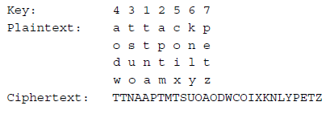
Transposition Techniques
For example,

Slide 68
Transposition Techniques
The key is 4312567.
To encrypt, start with the column that is labeled 1, in this case column 3. Write down all the letters in that column.
Proceed to column 4, which is labeled 2, then column 2, then column 1, then columns 5, 6, and 7.

Slide 69
Transposition Techniques
A pure transposition cipher is easily recognized because it has the same letter frequencies as the original plaintext.
Cryptanalysis is fairly straightforward
Involves laying out the ciphertext in a matrix and playing around with column positions.
Digram and trigram frequency tables can be useful.

Slide 70
Transposition Techniques
The transposition cipher can be made significantly more secure
By performing more than one stage of transposition.
The result is a more complex permutation that is not easily reconstructed.

Slide 71
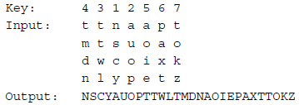
Transposition Techniques
If the foregoing message is re-encrypted using the same algorithm

Slide 72
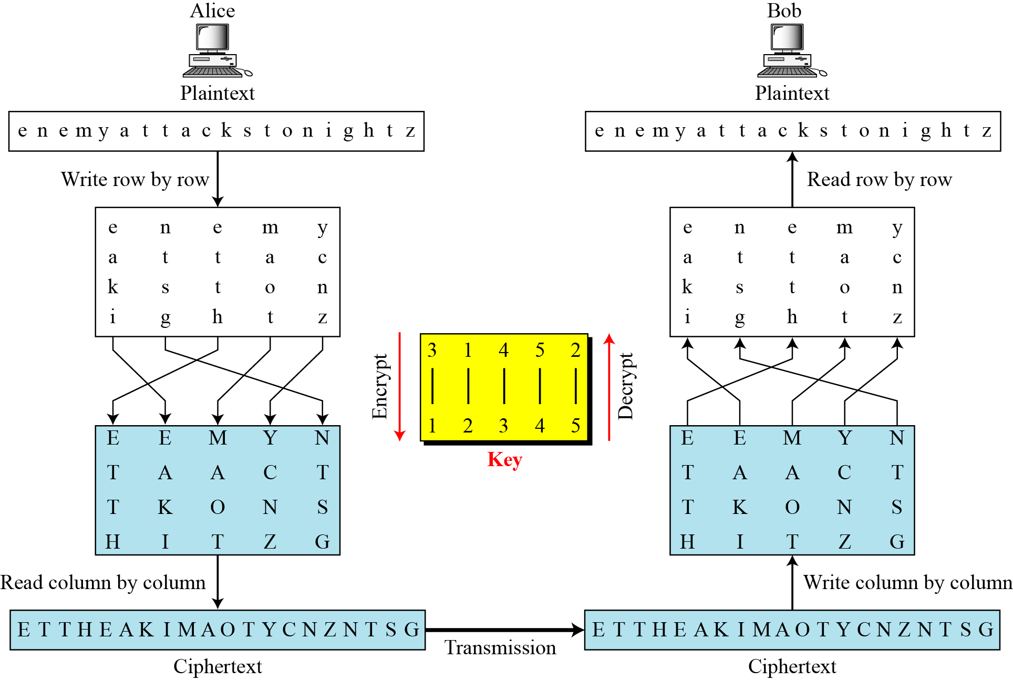
Combining Two Approaches
Example 3.26
Figure
3.*
Notes:
*

Slide 73
Classical Encryption Techniques
Substitution
  One in which the letters of plaintext are replaced by other letters or by numbers or symbols.
  If the plaintext is viewed as a sequence of bits, then substitution involves replacing plaintext bit patterns with ciphertext bit patterns.

Slide 74
Caesar Cipher
  The earliest known, and the simplest, use of a substitution cipher was by Julius Caesar.
  The Caesar cipher involves replacing each letter of the alphabet with the letter standing three places further down the alphabet. For example,

Slide 75

Caesar Cipher
  For example,
  Note that the alphabet is wrapped around, so that the letter following Z is A.
  We can define the transformation by listing all possibilities, as follows:

Slide 76
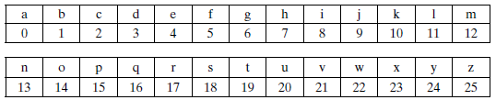
Caesar Cipher
  Let us assign a numerical equivalent to each letter:
  Then the algorithm can be expressed as follows. For each plaintext letter p, substitute the ciphertext letter C:
  C = E(3, p) = (p + 3) mod 26

Slide 77
Caesar Cipher
  A shift may be of any amount, so that the general Caesar algorithm is
  C = E(k, p) = (p + k) mod 26
  where k takes on a value in the range 1 to 25.
  The decryption algorithm is simply
  p = D(k, C) = (C - k) mod 26
  If it is known that a given cipher text is a Caesar cipher, then a brute-force cryptanalysis is easily performed: simply try all the 25 possible keys.

Slide 78
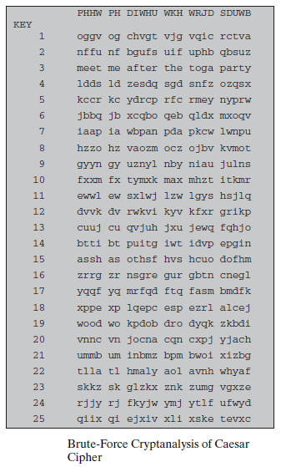
Brute-Force Cryptanalysis of Caesar Cipher
  The results of applying this strategy to the example ciphertext.
  In this case, the plaintext leaps out as occupying the third line.

Slide 79
Caesar Cipher
  A shift may be of any amount, so that the general Caesar algorithm is
  C = E(k, p) = (p + k) mod 26
  where k takes on a value in the range 1 to 25.
  The decryption algorithm is simply
  p = D(k, C) = (C - k) mod 26
  If it is known that a given cipher text is a Caesar cipher, then a brute-force cryptanalysis is easily performed: simply try all the 25 possible keys.

Slide 80
Caesar Cipher
With only 25 possible keys, the Caesar cipher is far from secure.
A dramatic increase in the key space can be achieved by allowing an arbitrary substitution.
Permutation!!

Slide 81
Caesar Cipher
A permutation of a finite set of elements S is an ordered sequence of all the elements of S, with each element appearing exactly once.
For example,
S = {a, b, c}, there are six permutations of S:
abc, acb, bac, bca, cab, cba
There are n! permutations of a set of n elements,
  The first element can be chosen in one of n ways,
  The second in n - 1 ways,
  The third in n – 2 ways, and so on.

Slide 82
Caesar Cipher
Caesar Cipher-
If, instead, the “cipher” line can be any permutation of the 26 alphabetic characters, then there are 26! possible keys.
Such an approach is referred to as a monoalphabetic substitution cipher, because a single cipher alphabet (mapping from plain alphabet to cipher alphabet) is used per message.

Slide 83
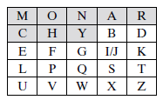
Playfair Cipher
Playfair, treats digrams in the plaintext as single units
Translates these units into ciphertext digrams
The Playfair algorithm is based on the use of a 5 * 5 matrix of letters constructed using a keyword.
In this case, the keyword is monarchy

Slide 84
Playfair Cipher
The matrix is constructed by filling in the letters of the keyword (minus duplicates) from left to right and from top to bottom, and then filling in the remainder of the matrix with the remaining letters in alphabetic order.
The letters I and J count as one letter.

Slide 85
Playfair Cipher
Plaintext is encrypted two letters at a time, according to the following rules:
Repeating plaintext letters that are in the same pair are separated with a filler letter, such as x, so that balloon would be treated as ba lx lo on.

Slide 86
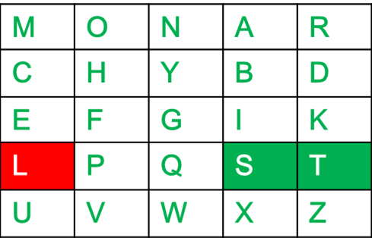
Playfair Cipher
Plaintext is encrypted two letters at a time, according to the following rules:
Two plaintext letters that fall in the same row of the matrix are each replaced by the letter to the right, with the first element of the row circularly following the last.
For example, ar is encrypted as RM, st=TL

Slide 87
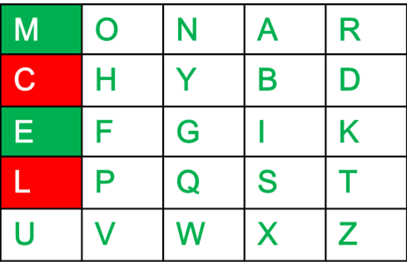
Playfair Cipher
Plaintext is encrypted two letters at a time, according to the following rules:
Two plaintext letters that fall in the same column are each replaced by the letter beneath, with the top element of the column circularly following the last.
For example, mu is encrypted as CM, me=CL

Slide 88
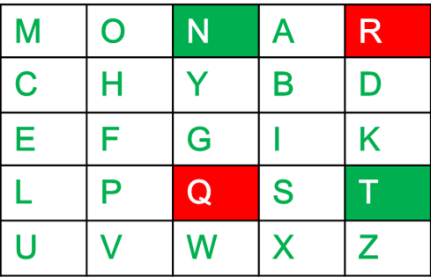
Playfair Cipher
Otherwise, each plaintext letter in a pair is replaced by the letter that lies in its own row and the column occupied by the other plaintext letter. Thus, hs becomes BP and ea becomes IM (or JM, as the encipherer wishes).
Diagraph: "nt" Encrypted Text: rq

Slide 89
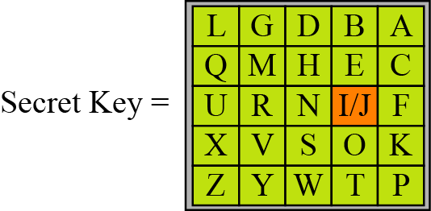
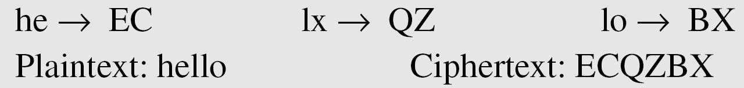
Playfair Cipher
Figure An example of a secret key matrix in the Playfair cipher
Example 3.15
Let us encrypt the plaintext “hello” using the key in given Figure
3.*
Notes:
*

Slide 90
Cryptanalysis of Playfair Cipher
Brute force is difficult
Size of key domain 25!
Hides single letter frequency of characters
Still leaves much of the structure of the plaintext language intact.
A few hundred letters of ciphertext are generally sufficient
Cryptanalyst can have ciphertext only attack based on digram frequency test to find the key

Slide 91
Polyalphabetic Cipher
Another way to improve on the simple monoalphabetic technique is to use different monoalphabetic substitutions as one proceeds through the plaintext message.
Called as polyalphabetic substitution cipher.
All these techniques have the following features in common:
A set of related mono alphabetic substitution rules is used.
A key determines which particular rule is chosen for a given transformation.

Slide 92
Monoalphabetic vs Polyalphabetic Cipher
Monoalphabetic cipher-
The cipher alphabet for each plain alphabet is fixed throughout the encryption process.
For example, if ‘A’ is encrypted as ‘D’, for any number of occurrence in that plaintext, ‘A’ will always get encrypted to ‘D’.
Polyalphabetic Cipher –
The cipher alphabet for the plain alphabet may be different at different places during the encryption process.

Slide 93
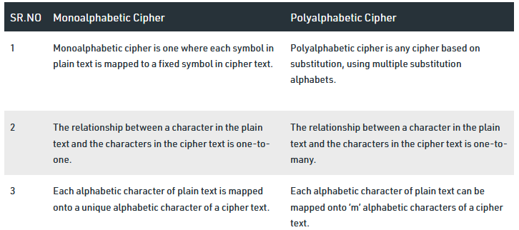
Monoalphabetic vs Polyalphabetic Cipher

Slide 94
Monoalphabetic vs Polyalphabetic Cipher
Note
In monoalphabetic substitution, the relationship between a symbol in the plaintext to a symbol in the ciphertext is always one-to-one.
3.*
Notes:
*

Slide 95
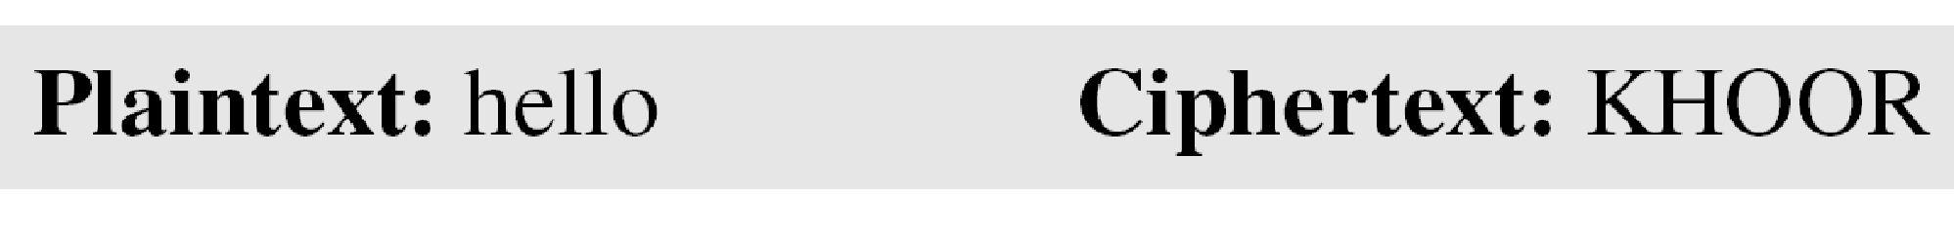
Monoalphabetic vs Polyalphabetic Cipher
Example 3.1
The following shows a plaintext and its corresponding ciphertext. The cipher is probably monoalphabetic because both l’s are encrypted as O’s.
Example 3.2
The following shows a plaintext and its corresponding ciphertext. The cipher is not monoalphabetic because each l is encrypted by a different character.
Plain Text; hello Cipher text: ABNZF
3.*
Notes:
*

Slide 96
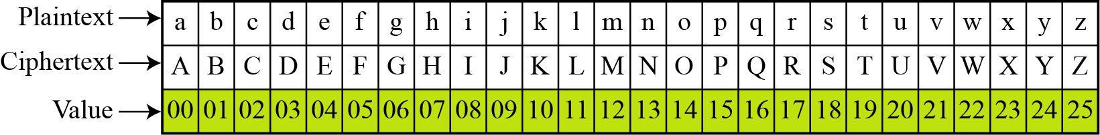
Eg of Monoalphabetic Cipher
The simplest mono alphabetic cipher is the additive cipher. This cipher is sometimes called a shift cipher and sometimes a Caesar cipher, but the term additive cipher better reveals its mathematical nature.
Figure Plaintext and ciphertext in Z₂₆
3.*
Notes:
*

Slide 97
Example 3.3
Use the additive cipher with key = 15 to encrypt the message “hello”.
3.*
Notes:
*

Slide 98
Example 3.3
Use the additive cipher with key = 15 to encrypt the message “hello”.
Solution
We apply the encryption algorithm to the plaintext, character by character:
3.*
Notes:
*

Slide 99
Example 3.4
Use the additive cipher with key = 15 to decrypt the message “WTAAD”.
3.*
Notes:
*

Slide 100
Example 3.4
Use the additive cipher with key = 15 to decrypt the message “WTAAD”.
Solution
We apply the decryption algorithm to the plaintext character by character:
3.*
Notes:
*

Slide 101
Example 3.5
Eve has intercepted the ciphertext “UVACLYFZLJBYL”. Show how she can use a brute-force attack to break the Caesar cipher.
3.*
Notes:
*

Slide 102
Example 3.5
Eve has intercepted the ciphertext “UVACLYFZLJBYL”. Show how she can use a brute-force attack to break the cipher.
Solution
Eve tries keys from 1 to 7. With a key of 7, the plaintext is “not very secure”, which makes sense.
3.*
Notes:
*

Slide 103
GATE | GATE-IT-2004 | Question 25
A sender is employing public key cryptography to send a secret message to a receiver. Which one of the following statements is TRUE?
(A) Sender encrypts using receiver’s public key
(B) Sender encrypts using his own public key
(C) Receiver decrypts using sender’s public key
(D) Receiver decrypts using his own public key

Slide 104
GATE | GATE-IT-2004 | Question 25
A sender is employing public key cryptography to send a secret message to a receiver. Which one of the following statements is TRUE?
(A) Sender encrypts using receiver’s public key
(B) Sender encrypts using his own public key
(C) Receiver decrypts using sender’s public key
(D) Receiver decrypts using his own public key
Answer: (A)

Slide 105
TYPES OF KEYS
Public key
Private key
Symmetric key
Session key
keystream
Passphrase
Key protection/encryption keys
Access keys/granting keys
Data encryption keys
Prof. Shweta Dhawan Chachra

Slide 106
Symmetric Key (Secret Key)
Used in: Symmetric encryption
Key characteristic: Same key used for encryption and decryption
Examples:
AES key (Advanced Encryption Standard) – 128, 192, or 256 bits
DES key (Data Encryption Standard) – 56 bits (now obsolete)
3DES key – 112 or 168 bits
RC4, RC5, RC6 keys
Prof. Shweta Dhawan Chachra

Slide 107
Asymmetric Key (Public/Private Key Pair)
Used in: Asymmetric encryption, digital signatures, key exchange
Key characteristic: Public key for encryption or signature verification; private key for decryption or signing
Examples:
  Public Key – Used to encrypt data or verify digital signatures
  Private Key – Used to decrypt data or create digital signatures
  RSA Key – Common in email and secure web communication
  ECC Key – Elliptic Curve Cryptography (e.g., P-256, Ed25519)
  DSA Key – Digital Signature Algorithm
  ElGamal Key – Often used for encryption based on Diffie–Hellman

Slide 108
Public Key
Used in: Encryption or signature verification
Key characteristic: Can be shared openly
Prof. Shweta Dhawan Chachra

Slide 109
Private Key
Used in: Decryption or digital signing
Key characteristic: Must be kept secret; compromise means full access
Prof. Shweta Dhawan Chachra

Slide 110
Session Key
Used in: Temporary communication sessions
Key characteristic: Ephemeral symmetric key generated for a single session
Often used with: TLS, VPNs, secure messaging
Prof. Shweta Dhawan Chachra

Slide 111
Key Exchange / Derivation / Wrapping
Pre-shared Key (PSK) – Shared in advance, used in VPNs, Wi-Fi (WPA2-PSK)
Key Derivation Key (KDK) – Used in key derivation functions (KDFs)
Key Encryption Key (KEK) – Encrypts other keys, not data directly
Master Key / Root Key – Base key used to derive or sign other keys
Prof. Shweta Dhawan Chachra

Slide 112
Application-Specific Keys
Data Encryption Key (DEK) – Specifically used to encrypt data (e.g., in databases, cloud storage)
Authentication Key (Auth Key) – Used in MACs (Message Authentication Codes), HMACs, and digital signatures
Passphrase / Password Key – A human-memorable string often turned into a cryptographic key via a KDF (like PBKDF2, scrypt, Argon2)

Slide 113
Passphrase
A passphrase is a human-readable string (often multiple words) used to derive a cryptographic key. It's similar to a password but typically longer and more secure.
Usage:
  Protect private keys (e.g., PGP or SSH keys)
  Used in key derivation functions (KDFs) like PBKDF2, scrypt, Argon2
  Encrypt files, devices, or secure messages
Example:
"correct horse battery staple" → used to generate a 256-bit encryption key

Slide 114
Keystream
Definition:
A keystream is a sequence of bits or bytes generated by a stream cipher, which is combined (usually XORed) with plaintext to produce ciphertext.
Usage:
  Core component in stream ciphers like RC4, ChaCha20, Salsa20
  Ensures data is encrypted bit by bit or byte by byte
Properties:
  Must be random-looking and synchronized between sender and receiver
  Should never be reused with the same key (to avoid attacks)
Example:
Plaintext: 10110100
Keystream: 01001110
Ciphertext = Plaintext XOR Keystream = 11111010
Prof. Shweta Dhawan Chachra

Slide 115
Question
What is salt?
How passwords are stored in databases?
Prof. Shweta Dhawan Chachra

